Slide 1

2025 IEEE INTERNATIONAL CONFERENCE ON EMERGING TRENDS IN ENGINEERING A ND COMPUTING (ETECOM)
29-30 OCTOBER 20 25
Enabling Equitable EV Charger Deployment in Berlin with Multi-Objective Geospatial Optimization
Presented by : Clifford Omari Ondieki
CO-AUTHORS: Tianxiang Lu

Slide 2
Content
Introduction
Methodology
Input Data
The Optimisation
The Simulation
Impact, Limitations, and Outlook
Conclusion
References
Questions and Contact

Slide 3
The Challenge: Germany's Ambitious EV Goals
1 Million Chargers by 2030
Market-Driven "Charging Deserts"
Inequality Barrier
Germany's national target requires strategic deployment across all regions
Current deployment creates uneven coverage, leaving outer districts underserved
Unequal access reinforces social divides and slows widespread EV adoption
Our Research Question
How can a data-driven optimization framework balance the competing objectives of network utility and spatial equity in EV charger deployment?

Slide 4
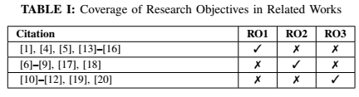



Related Works and Contribution
RO1 – Identifying Bottlenecks
RO2 – Designing Governance Models
RO3 – Field Evaluation and Distribution
Integrate empirical,
official datasets
Operationalize city-scale
planning
Simulate operational
outcomes
Official sources: BNetzA, KBA, Berlin Open Data
Multi-objective algorithm balancing competing priorities
Clear trade-offs for informed decision-making

Slide 5
Methodology: Multi-Objective Optimization Approach
Diagnosis: Baseline analysis of current network congestion and equity gaps.
Optimization (NSGA-II): Multi-Objective Genetic Algorithm to identify Pareto-optimal trade-offs between two objectives:
Maximize Network Utility
Maximize Spatial Equity
Serve the maximum number of potential users through strategic placement in high-demand areas
Ensure fair distribution across all districts, minimizing the Gini coefficient of access
Population density analysis
Equal service levels
Existing infrastructure gaps
Reduced congestion ratios
Travel pattern optimization
Inclusive accessibility
Simulation (Queuing Model): Validate the optimal policy scenarios using a stochastic model to assess operational metrics (wait times, utilization).

Slide 6
Input Data
Spatial Unit: Berlin's 12 Administrative Districts.
Data Sources (Q2 2025):
Chargers: BNetzA Ladesäulenregister (Locations, Types).
Demand: KBA (BEV Registration counts).
Context: Berlin Open Data (District Boundaries, Population).
Baseline Metrics Calculated:
Charger Density: Chargers per km2.
Network Pressure: BEVs/Charger (The core metric used for the Equity objective).
We filtered [D1] to Berlin districts and aggregated charger counts. BEV registration numbers [D2] were distributed by district population [D4]. Spatial analysis used boundaries and charger positions from [D3a-b] to compute charger density and BEVs-per-charger by district, forming the baseline for simulation.
[D1] BNetzA Ladesaulenregister (public charging station registry) [21]
[D2] KBA (BEV registrations) [22]
[D3] Berlin Open Data: (a) 12 district boundaries (bezirksgrenzen.geojson) (b) Public charger locations (chargers locations.geojson) [23]
[D4] Amt fur Statistik Berlin-Brandenburg (population data) [24]
[D5] InfraMobility GmbH; Stromnetz Berlin (grid/transport supplement)
[D6] EAFO (international comparison) [25]

Slide 7
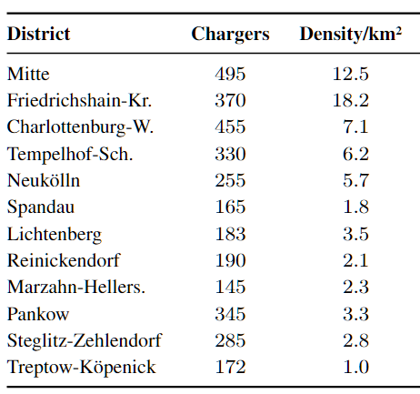
Berlin's Current Reality: The Data Reveals Stark Imbalances
The data reveals a concerning pattern: central districts have abundant charging infrastructure while outer districts face severe congestion.
Outer districts show 3-4x higher BEV-to-charger ratios, creating barriers to EV adoption in these areas
Quantitative Diagnosis:
Charger Density: 18.2 Density/km2 (Center) vs 1.0 Density/km2 (Periphery.)
User Congestion: Pressure is highest in the outer district
Consequence: Unequal access reinforces social devides and slows city wide EV adoption

Slide 8
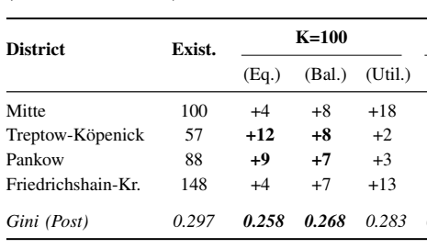
Real Impact: How Strategies Allocate 100 New Chargers
Mitte (Max Utility)
Central district prioritized for maximum coverage
Treptow-Köpenick (Max Equity)
Outer district receives significant investment
Treptow-Köpenick (Max Utility)
Same district under utility-focused strategy
The choice of optimization strategy has massive implications for where infrastructure gets built and which communities benefit most.

Slide 9
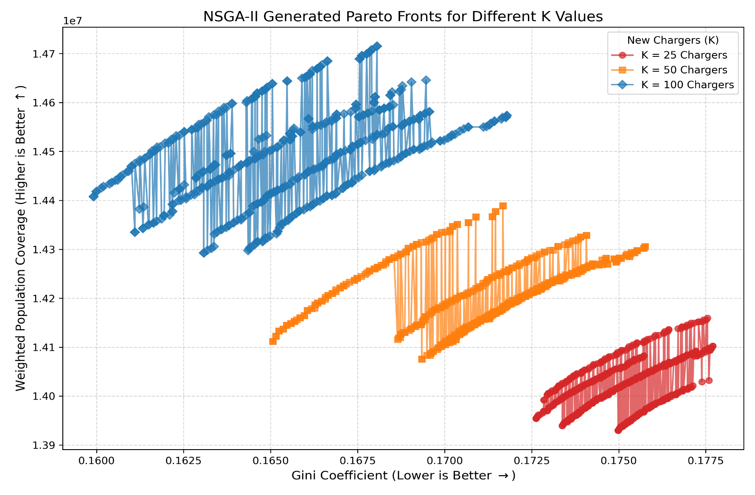
Key Finding: The Pareto Front Reveals Optimal Trade-offs
Three Representative Strategies
Strategy A (Max Equity): Lowest Gini coefficient, fairest distribution
Strategy B (Balanced): Optimal compromise between goals
Strategy C (Max Utility): Highest coverage, serves most users
Lower Gini = More EquitableHigher Coverage = More Utility
There is no single "perfect" solution—only optimal trade-offs that reflect different policy priorities.

Slide 10
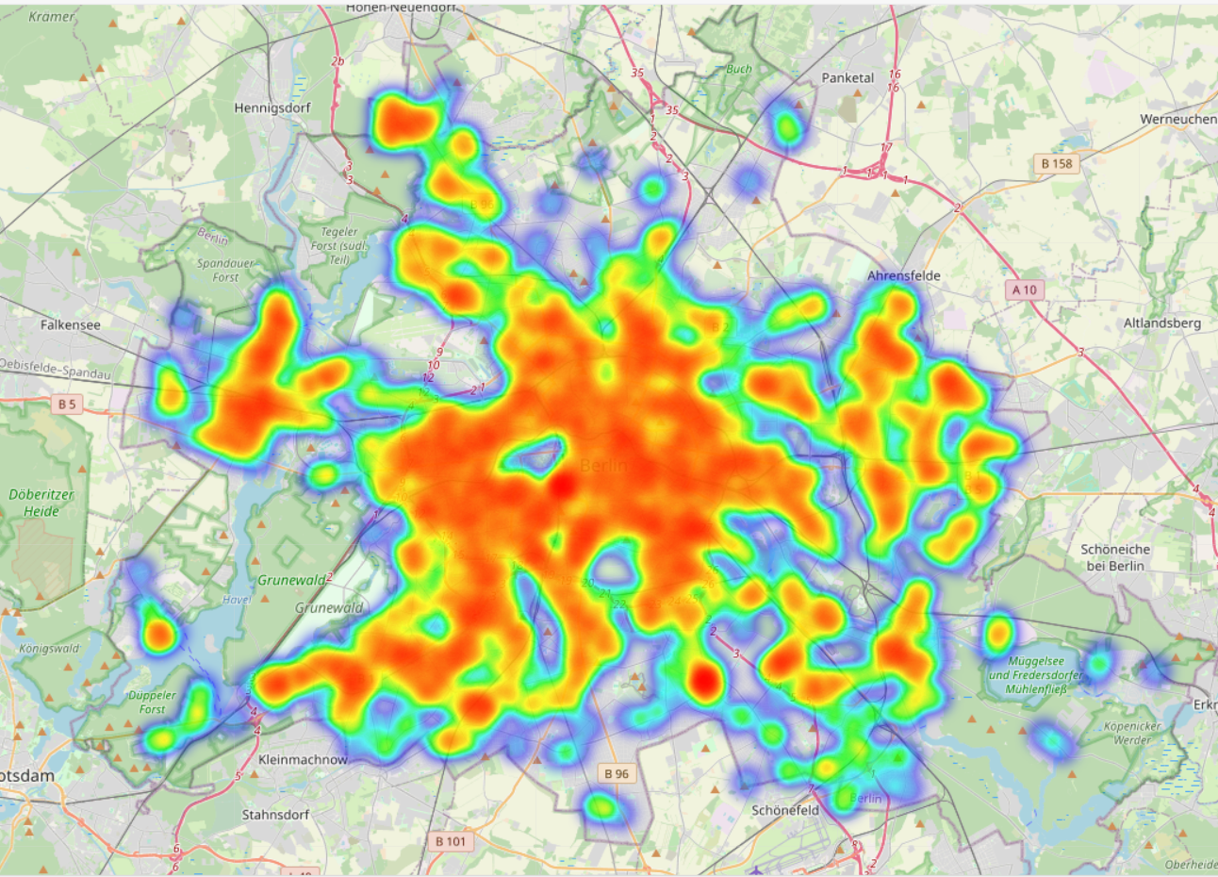
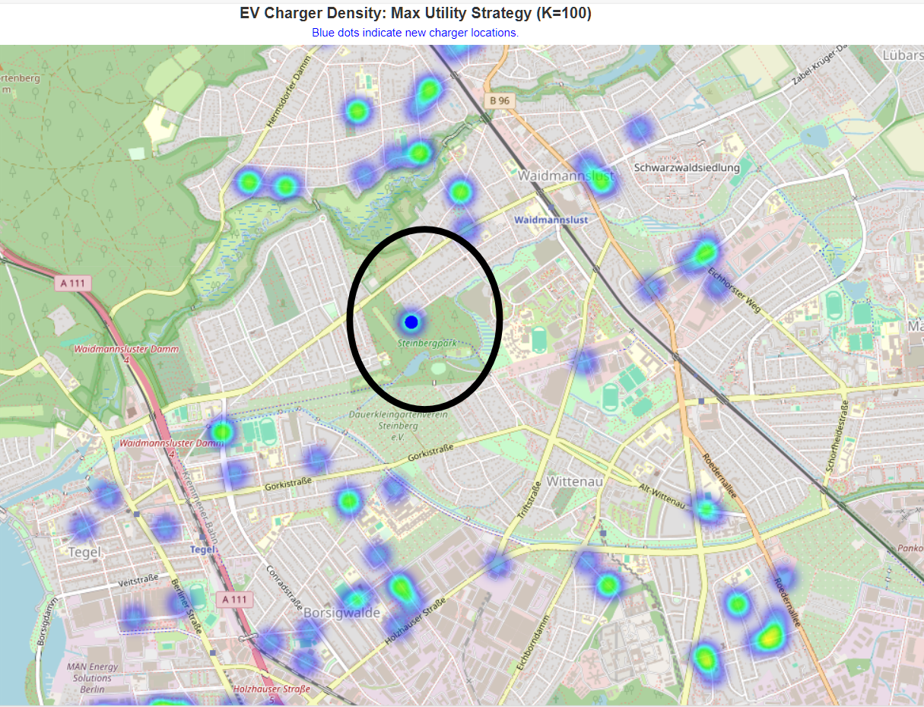
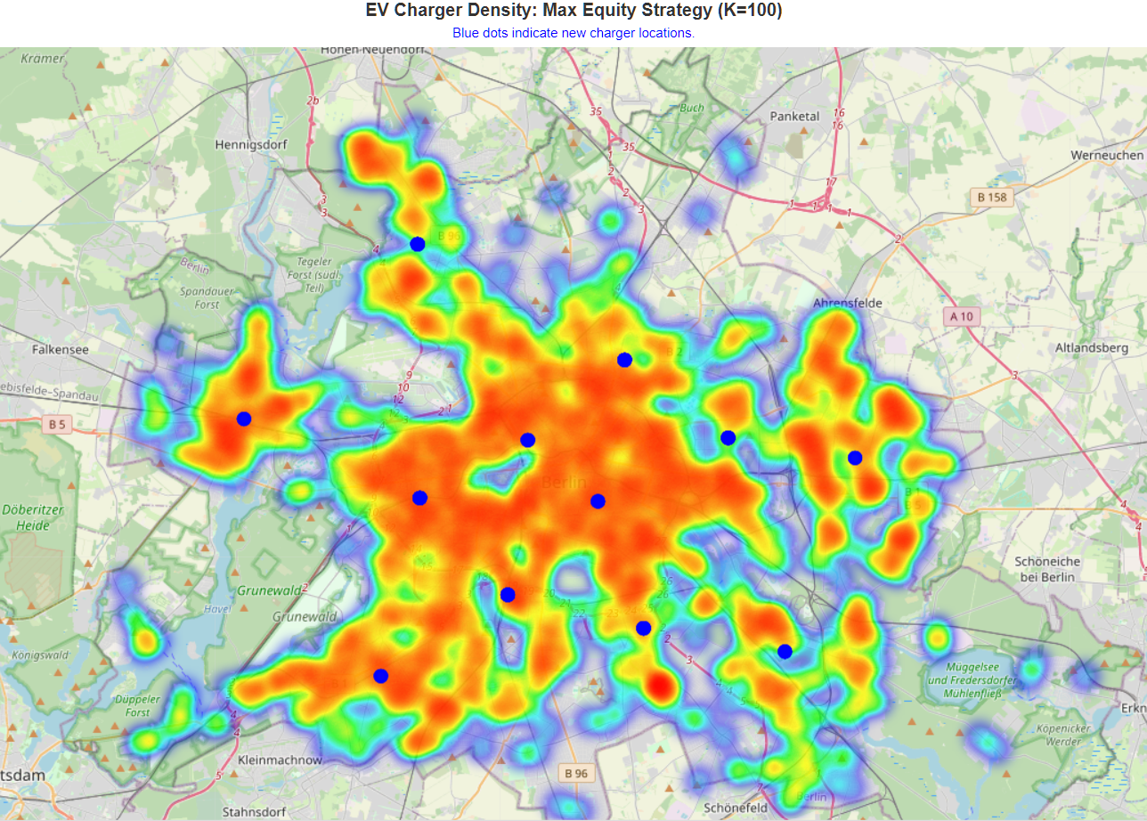
Simulation Results
Current Baseline
Max Utility Strategy
Max Equity Strategy
Heavy clustering in central Berlin, sparse coverage in outer districts
Intensifies existing hotspots, maximizes short-term service coverage
Fills coverage gaps, creates balanced access across all communities with less wait times

Slide 11

Impact, Limitations, and Outlook
Our framework transforms political debates into evidence-based choices, providing policymakers with clear trade-offs and their consequences.
Impact:
Quantifies Trade-off: Provides a quantitative foundation for policy debates on utility vs. equity.
Actionable Guidance: Offers transparent, implementable deployment strategies to planners.
Limitations:
Spatial Resolution: Gini coefficient is district-level; does not use fine-grained metrics (e.g., 2SFCA).
Model Simplification: Excludes explicit grid capacity or detailed land-use siting feasibility.
Future Enhancements:
Integration of finer-grained analysis, grid capacity constraints, and land use considerations will further refine these optimization strategies.
Ultimate validation requires a quasi-experimental roll-out (e.g., Difference-in-Differences).

Slide 12
Conclusion: Policy for a Fairer Transition
The research successfully developed and validated a multi-objective framework to reconcile the competing demands of utility and equity.
The Max Equity strategy is demonstrably superior for achieving an inclusive transition:
- 13% lower Gini coefficient.
- 21% higher local access in underserved districts.
3. Lower overall queueing delays.
Key Takeaway:
Strategic investment in equity is not a drag on efficiency; it is a vital mechanism for optimizing the entire urban EV network.

Slide 13
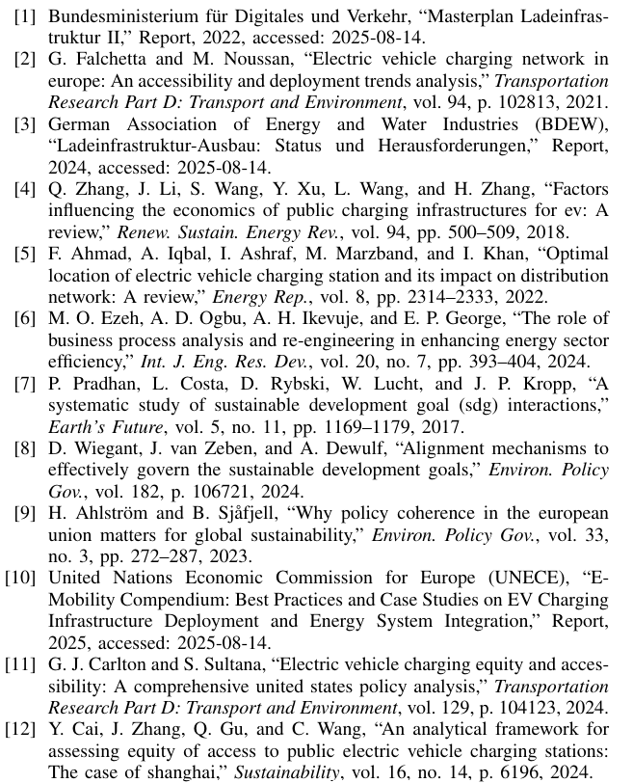
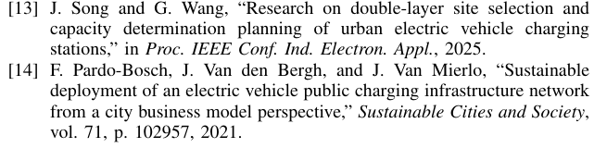
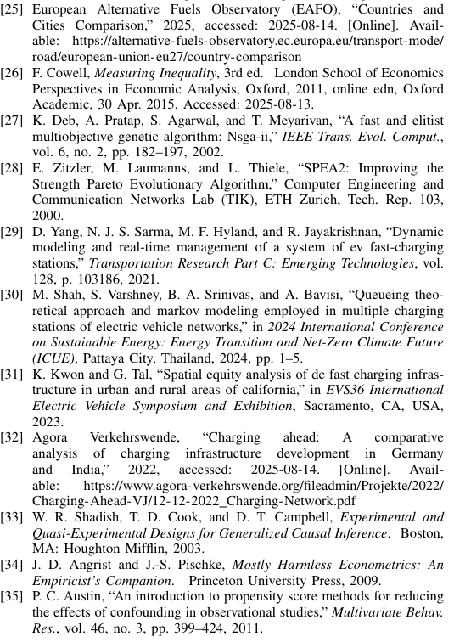
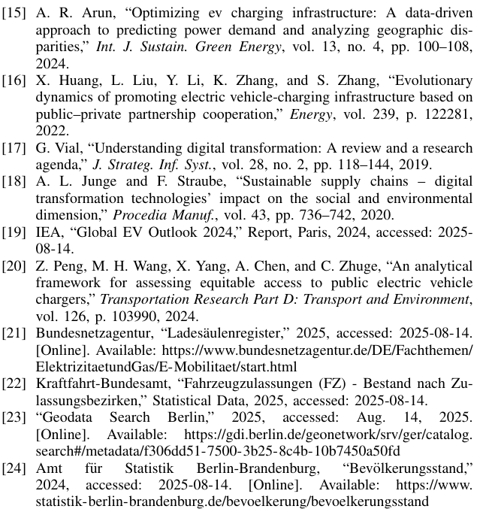
References

Slide 14



Contact
Thank you for your attention.
Any questions?
Clifford Omari Ondieki
Prof. Dr. rer. nat. Tianxiang Lu

